Slide 1
Stock Prophets:
Project 4 Group 6

Slide 2
The Prophets
Giovanna Lizzio
I ju Su (Selina Su)
Indra Nandagopal
Joshua Cressaty
Kelly Brown
Michael Ariwodo
Miranda Hermes
Mohamed Bilal
Marjorie Muñoz

Slide 3
The Vision
Forecast the stock prices up to 7 calendar days in the future using historical stock price data based on a ticker selected by the user.
Our Plan to Make it Happen:
Access data from a reliable source that is updated frequently
Extract, transform and load the data into a database
Try multiple machine learning models to determine the best one for the project
Build the user interface to allow ticker selection and future stock price predictions
Notes:
Kelly

Slide 4
Data
yfinance library in python
Reliable data from the NYSE
Included ticker symbol, date(s), open, high, low, close, adjclose, and volume
Simplified data to ticker symbol, date(s), and close value
Time period for data:
01/01/2010 to present or date the ticker went public – which ever occurred first
Historical price data per ticker: (Note: Doesn’t include emotional sentiment or newsworthy events impacting prices)
ETL (removing dupes & null values)handled in python before moving to SQLite
Notes:
Josh

Slide 5

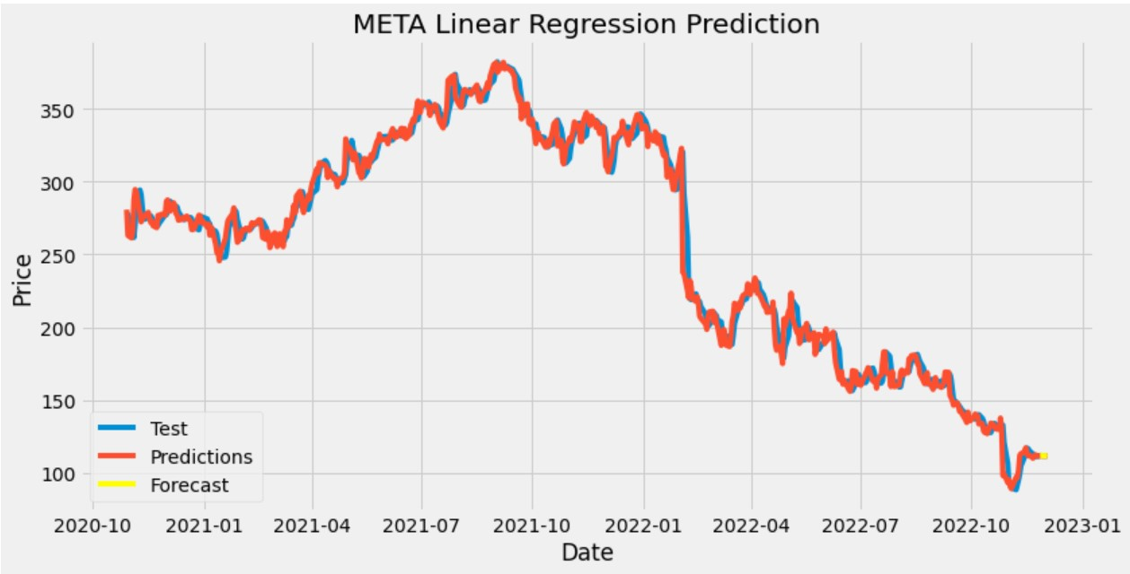
Machine Learning Model 1
Linear Regression – main model
Linear Regression is the supervised Machine Learning model in which the model finds the best fit linear line between the independent and dependent variable
80% Training 20% Testing Data Split
Notes:
Mohamed

Slide 6
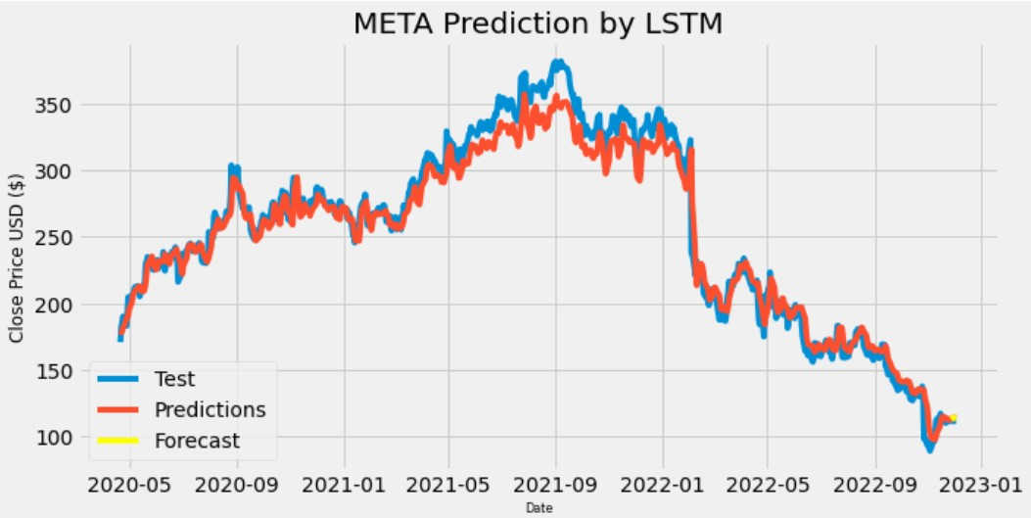
Machine Learning Model 2
LSTM –
Long Short Term Memory is a kind of recurrent neural network.
The LSTM model can be tuned for various parameters such as changing the number of LSTM layers, adding dropout value or increasing the number of epochs.
LSTM can by default retain the information for a long period of time. It is used for processing, predicting, and classifying on the basis of time-series data.
Used 50 neurons, 4 layers, 1 dense layer and drop out layers
Used “adam” optimizer
Long time to process
Notes:
Michael

Slide 7
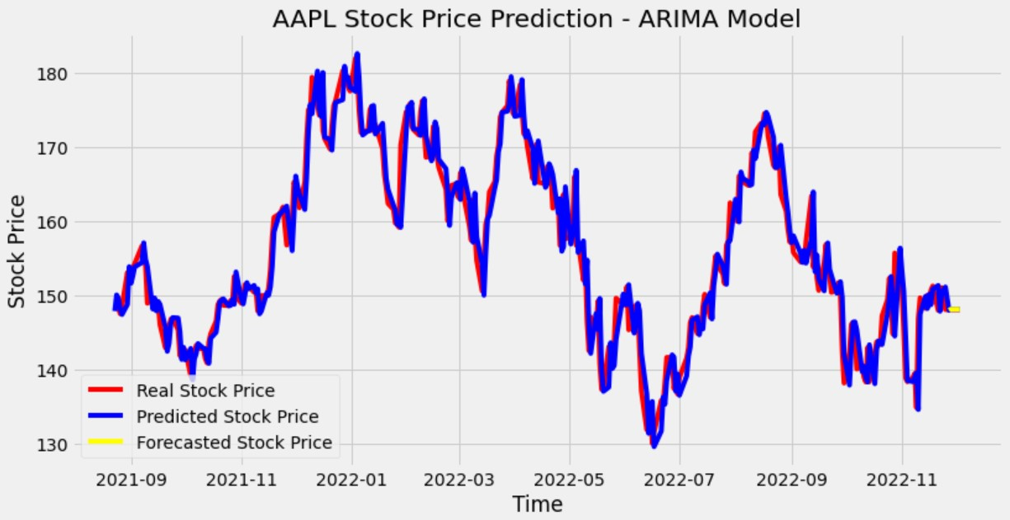
Machine Learning Model 3
ARIMA - Autoregressive Integrated Moving Average
used for forecasting time series data
ARIMA models are generally denoted as ARIMA (p,d,q) where p is the order of autoregressive model, d is the degree of differencing, and q is the order of moving-average model.
ARIMA models use differencing to convert a non-stationary time series into a stationary one, and then predict future values from historical data. These models use “auto” correlations and moving averages over residual errors in the data to forecast future values.
We trained the model with average of high & low stock prices and tested with “Close” stock price.
Used ARIMA(1,1,0) - differenced first-order autoregressive model
Performed better when train, test split is 80:20 compared to 90:10 split
Notes:
Indra

Slide 8
Accuracy of Models
R2 score for Linear Regression: 0.98
R2 score for LSTM Model: 0.97
R2 score for ARIMA Model : 0.99
Notes:
Giovanna

Slide 9
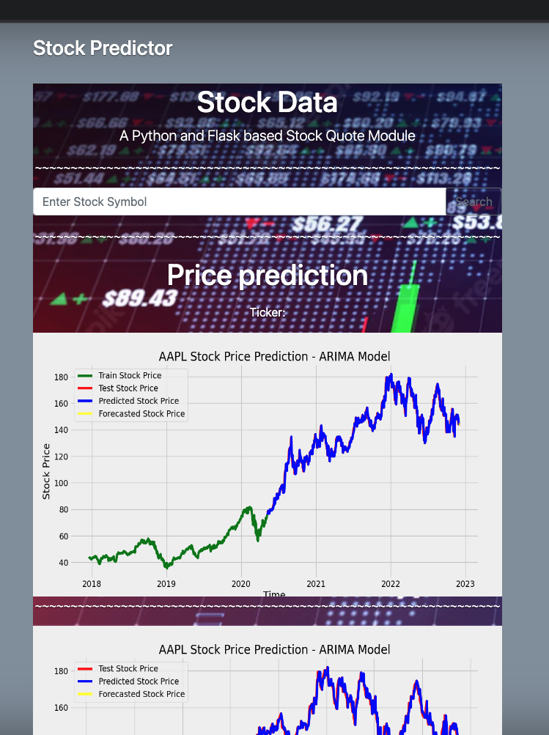
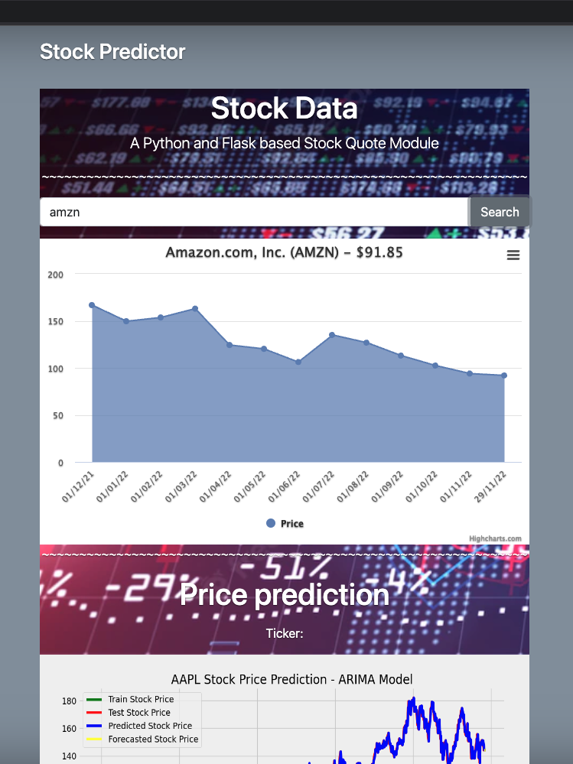
Flask App Dashboard
User-interaction dashboard
Using Python Flask, JavaScript, HTML and MongoDB to create
Using ARIMA Model – Classification
highest Accuracy among the models
Show the stock trend for each ticker requested
Predicts up to 7 calendar days ahead
Notes:
Selina

Slide 10
99 Problems…
Trouble passing user-defined ticker symbol to the models
Matplotlib or DIE! – Dependencies forgotten
The Never-Ending Loop Loop Loop Loop
Plt.show or HIDE? To return only dfs
Adding MongoDB to overcome pulling 1000s of rows from csv
MatplotDEAD – used pngs to display the results
Notes:
Marjorie

Slide 11
Future Project Considerations
Incorporate emotional sentiment and news data
Limit predictions to “open market days”
Allow user-defined start date of historical data look-up
Allow for stock comparisons of different tickers
Predict from quarterly earnings
Industry specific predictions
ETF/ Mutual Funds / Crypto / Options
SELL SELL SELL
Notes:
Miranda

